Slide 1


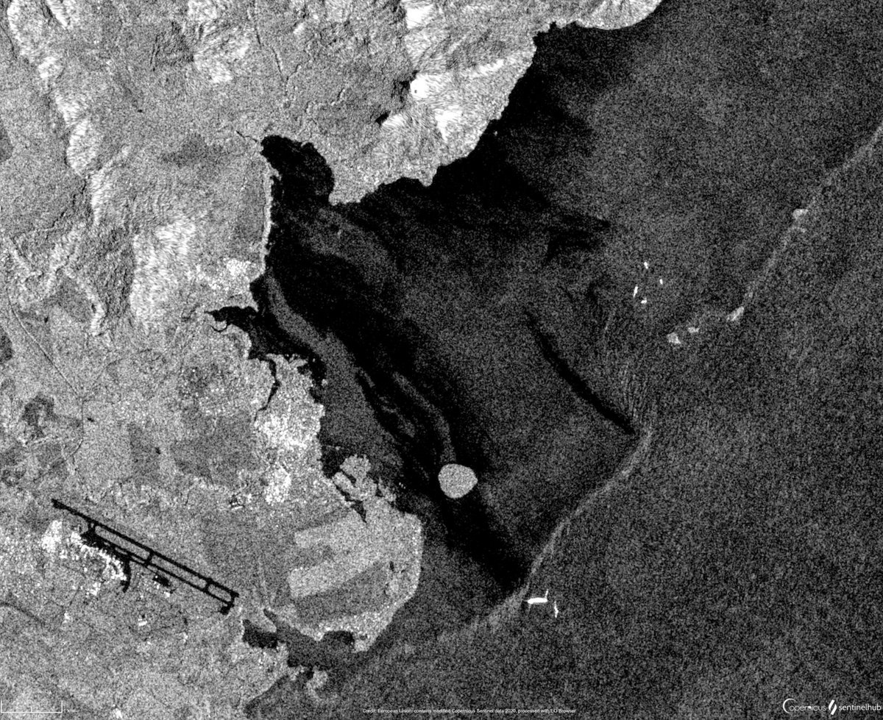

Neural Networks for
SAR Oil Spill Detection
Applied Data Science Project
Bianca Bartoli - s322799
Carlo Marra - s334220
Alessandro Valenti - s328131

Slide 2
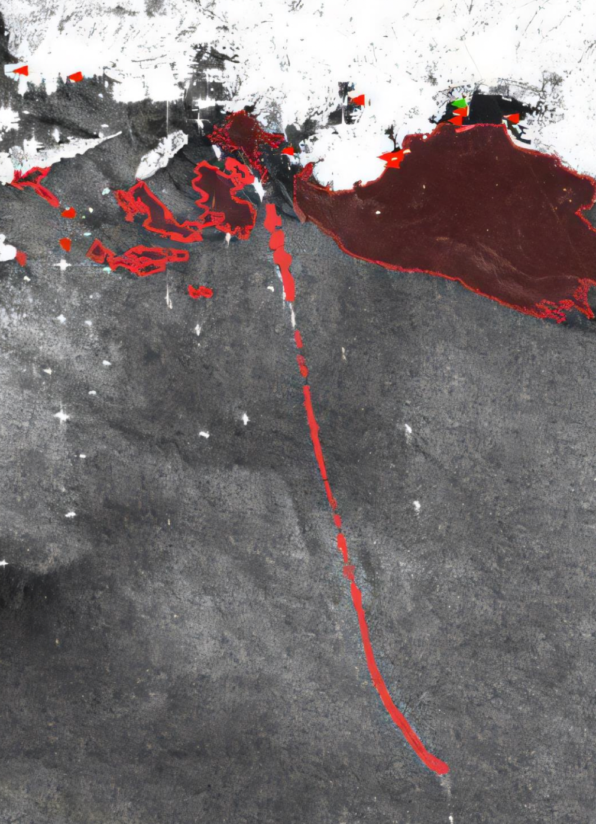





VALUE PROPOSITION
Main goal of the project: developing models to enable continuous monitoring and precise detection of oil spills
Oil spills pose a significant threat to marine ecosystems
Environmental Impact
Faster response times can significantly reduce the environmental damage caused by oil spills
Response Efficiency
Early detection and response help contain the spill, reducing the resources needed to manage its spread
Scalability
The developed system can be applied to any marine environment with SAR imaging availability, offering potential for global deployment

Slide 3
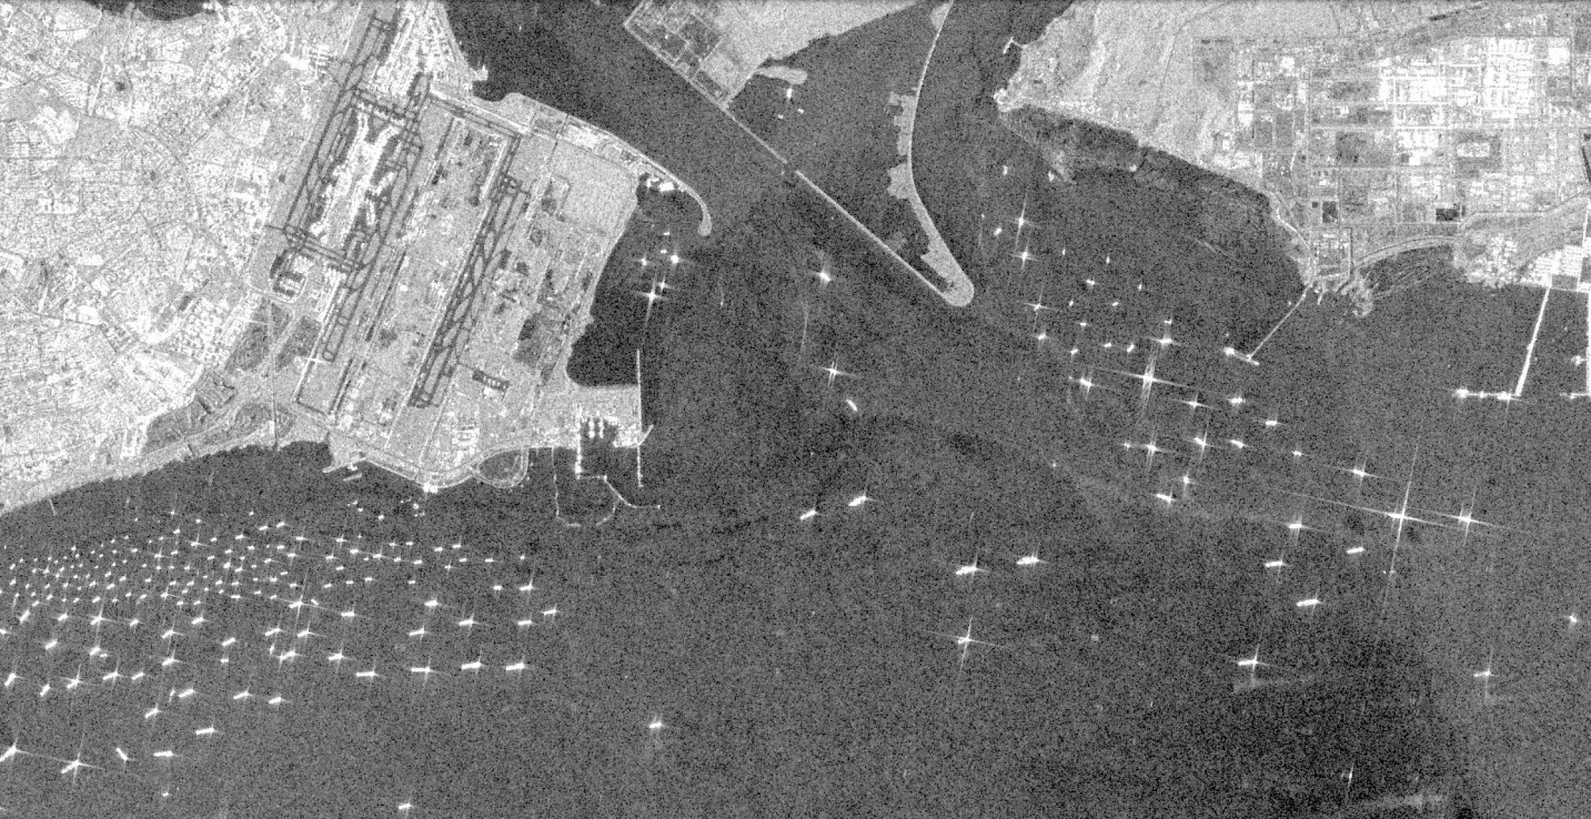


TASKS
Introduction:
Understand the oil spill issue
Review reference papers and resources
Paper replication:
Explore the dataset
Build a functional pipeline
Apply paper-specific augmentations
Reproduce all models
Evaluate and compare results
Development of improvements:
Design tailored augmentations
Implement CBDNet

Slide 4
GANTT
October 2024
November 2024
December 2024
January 2025
Project Management
Research and Familiarization
Data Exploration & Preprocessing
Model Implementation and Training
Evaluation and Comparison
Documentation & Communication
Checkpoint 2

Slide 5
DATASET EXPLORATION

Slide 6
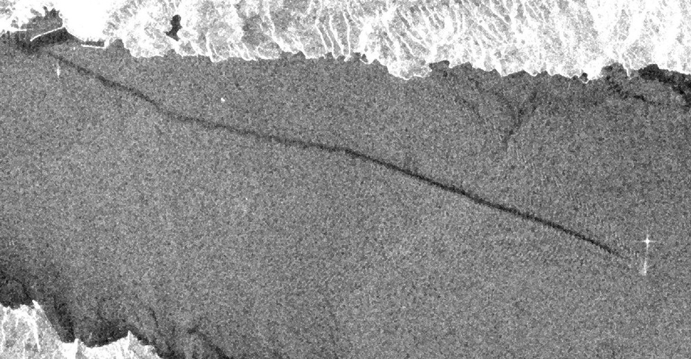
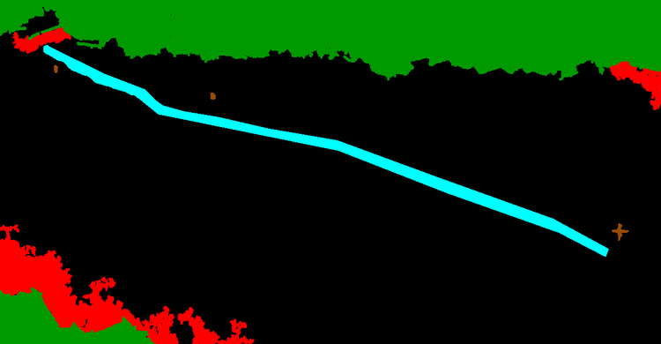

Images are taken by the ESA Satellite Sentinel-1
All images have dimensions 1250 x 650
Patches of dimension 320 x 320 are fed to models
4
1
0
3
2
Original SAR image
Ground truth mask
Explicit labels mask
3 greyscale identical channels
3 rgb channels
1 label channel
Sea Surface
0
Sea Surface
Oil Spill
1
Oil Spill
Look-alike
2
Look-alike
Ship
3
Ship
Land
4
Land

Slide 7
DATA PREPROCESSING

Slide 8
PAPER AUGMENTATIONS
Starting from the original image, the original paper performs:

Slide 9
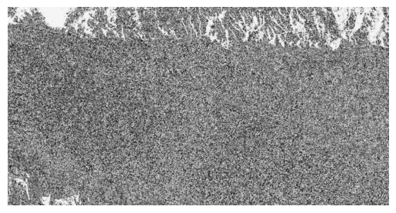
PAPER AUGMENTATIONS
Starting from the original image, the original paper performs:
Normalization

Slide 10
PAPER AUGMENTATIONS
Starting from the original image, the original paper performs:
Normalization
Random resize
with a scale from 0.5x to 1.5x

Slide 11
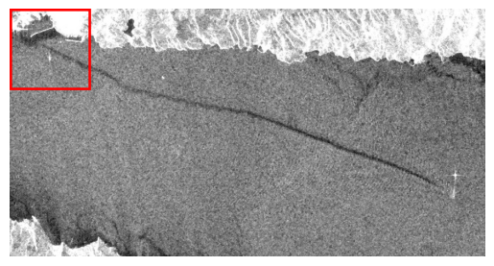
PAPER AUGMENTATIONS
Starting from the original image, the original paper performs:
Normalization
Random resize
with a scale from 0.5x to 1.5x
320x320 Crop

Slide 12
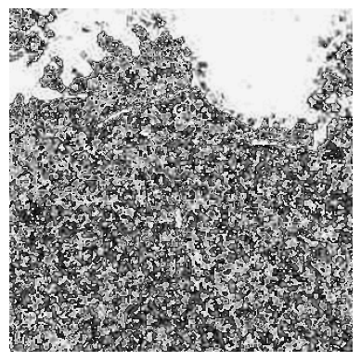
PAPER AUGMENTATIONS
Starting from the original image, the original paper performs:
Normalization
Random resize
with a scale from 0.5x to 1.5x
320x320 Crop

Slide 13
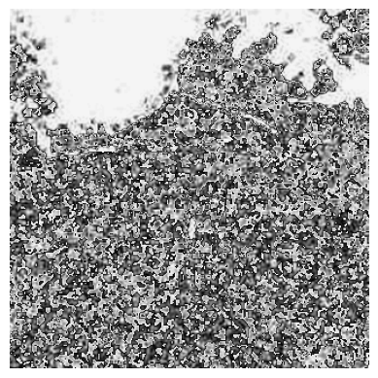
PAPER AUGMENTATIONS
Starting from the original image, the original paper performs:
Normalization
Random resize
with a scale from 0.5x to 1.5x
320x320 Crop
Horizontal Flip
with a probability of 50%

Slide 14
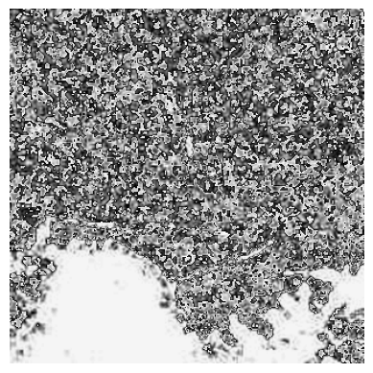
PAPER AUGMENTATIONS
Starting from the original image, the original paper performs:
Normalization
Random resize
with a scale from 0.5x to 1.5x
320x320 Crop
Horizontal Flip
with a probability of 50%
Vertical Flip
with a probability of 50%

Slide 15
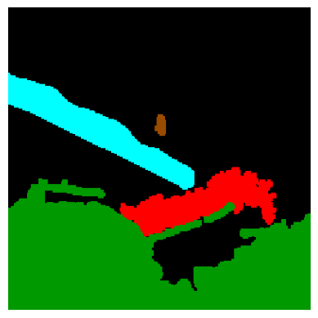
PAPER AUGMENTATIONS
Starting from the original image, the original paper performs:
Normalization
Random resize
with a scale from 0.5x to 1.5x
320x320 Crop
Horizontal Flip
with a probability of 50%
Vertical Flip
with a probability of 50%

Slide 16
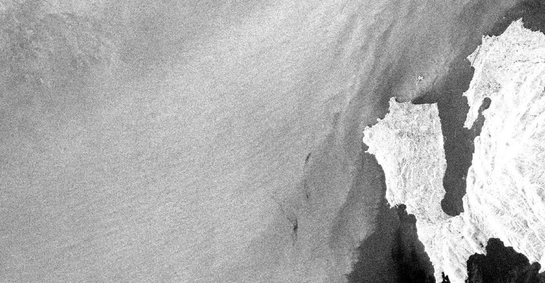
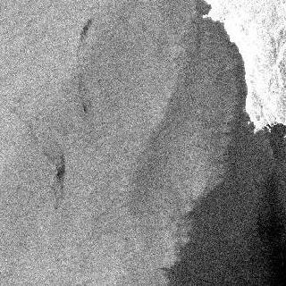
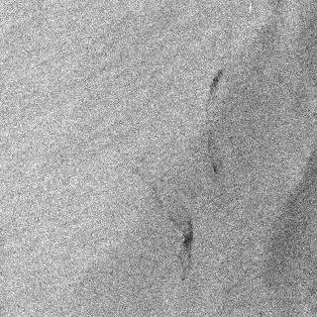

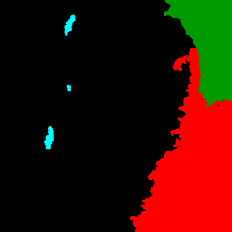

PROPOSED AUGMENTATIONS
Focused Crop on Oil Spill
Original Image
Focused Crop Examples
Colors and shadows Augmentation
...

Slide 17
IMPLEMENTATION

Slide 18
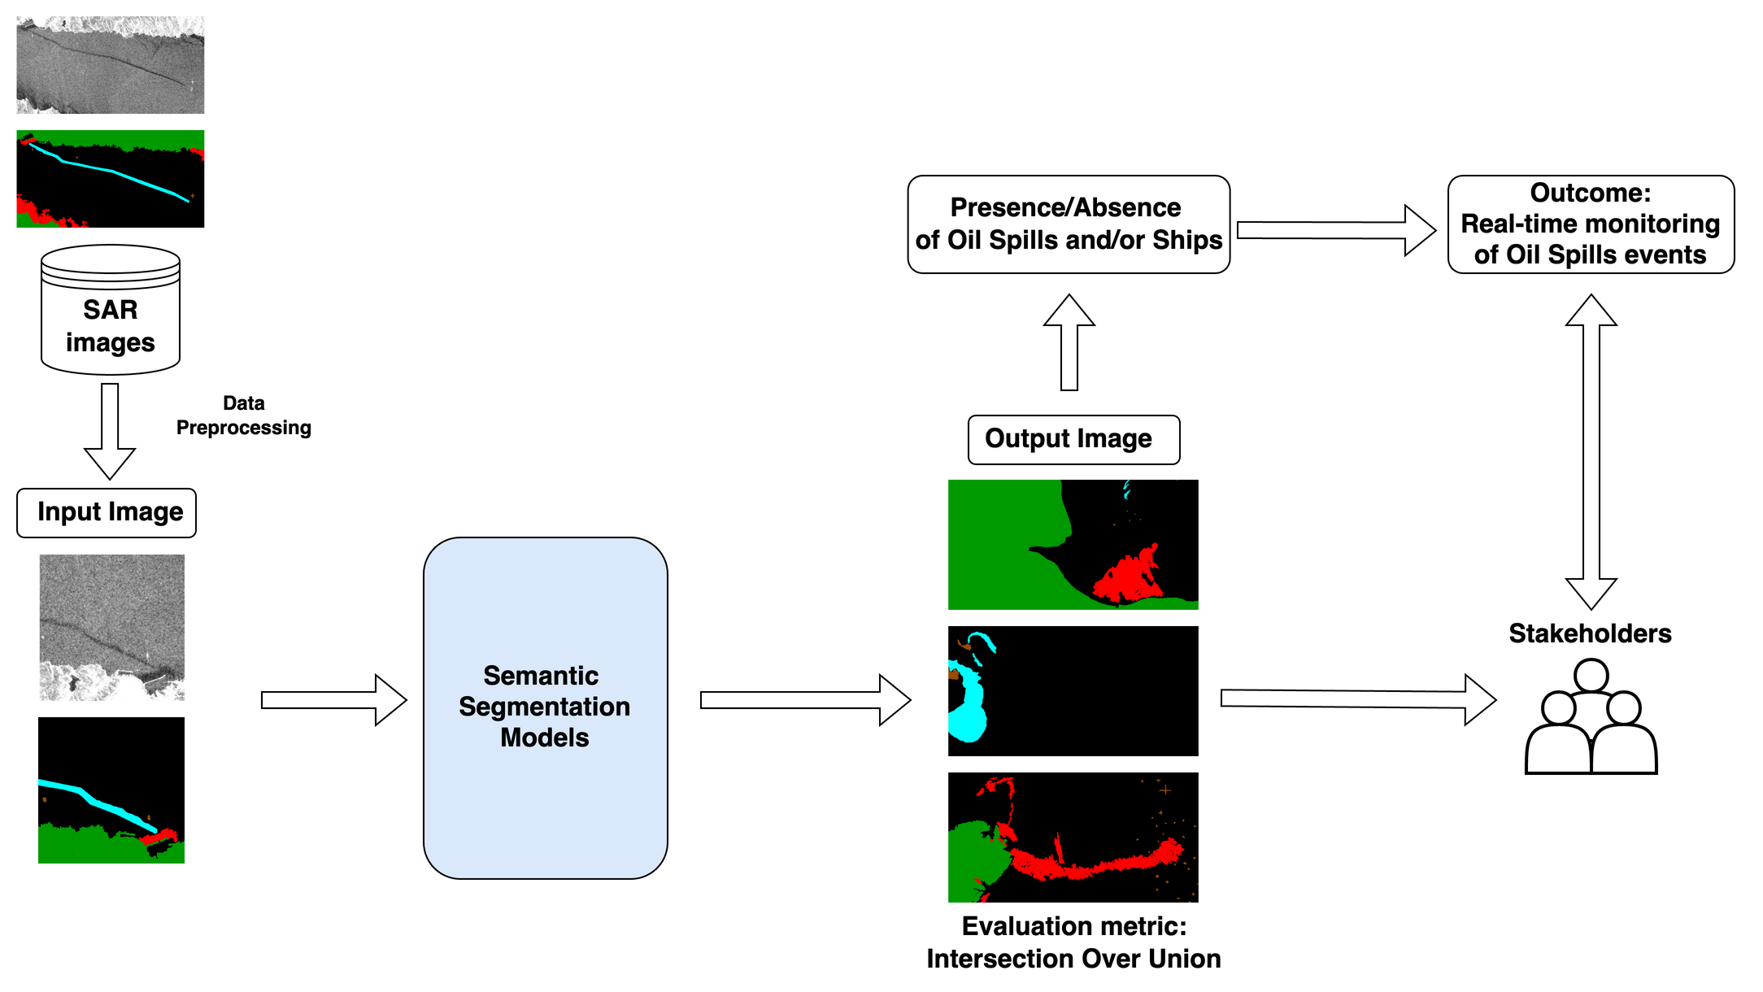
GENERAL OVERVIEW

Slide 19
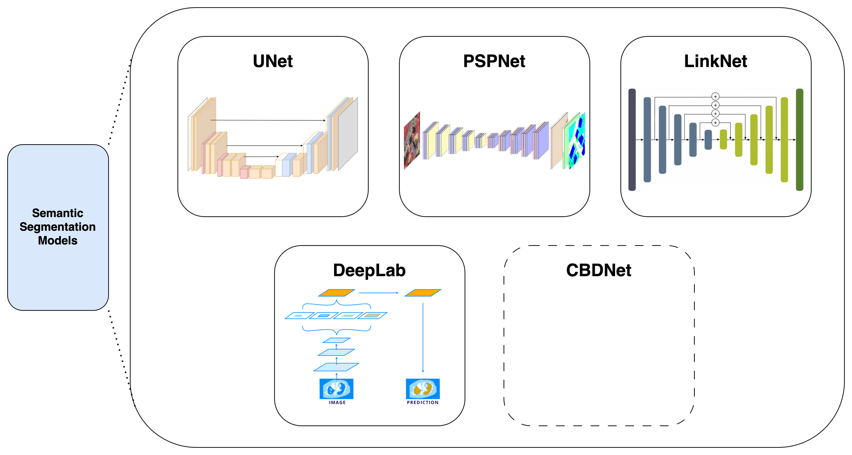
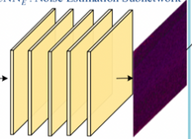
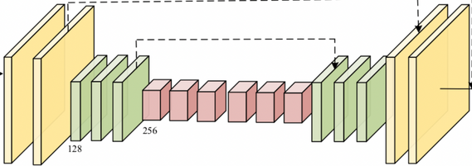
MODELS

Slide 20

TRAINING -
Dataset class:
Loads and preprocesses raw data into usable data points for training
The task:
Train and evaluate multiple models under varying preprocessing conditions to determine performance and robustness.
class SARImageDataset(Dataset)
Data Module class:
Manages data pipelines, including dataset splits and DataLoader creation
Chosen Framework:
We selected PyTorch Lightning as the primary framework for model development due to its support for modular workflows.
It streamlines data handling, training, and testing processes, making development more efficient and organized.
class SARDataModule(LightningDataModule)
Lightning Module class:
Defines the model, training / validation / testing logic, and optimizers
class SARSegmentationModel(LightningModule)

Slide 21
Thank you for your attention
Any questions?
Bianca Bartoli - s322799
Carlo Marra - s334220
Alessandro Valenti - s328131

